Slide 1
REVERSE CHARGE VAT Liz Bridge Secretary to the Joint Taxation Committee Autumn 2019 (Amended October 2020 )
Autumn 19

Slide 2
The Flow of VAT Before and After
14

Slide 3
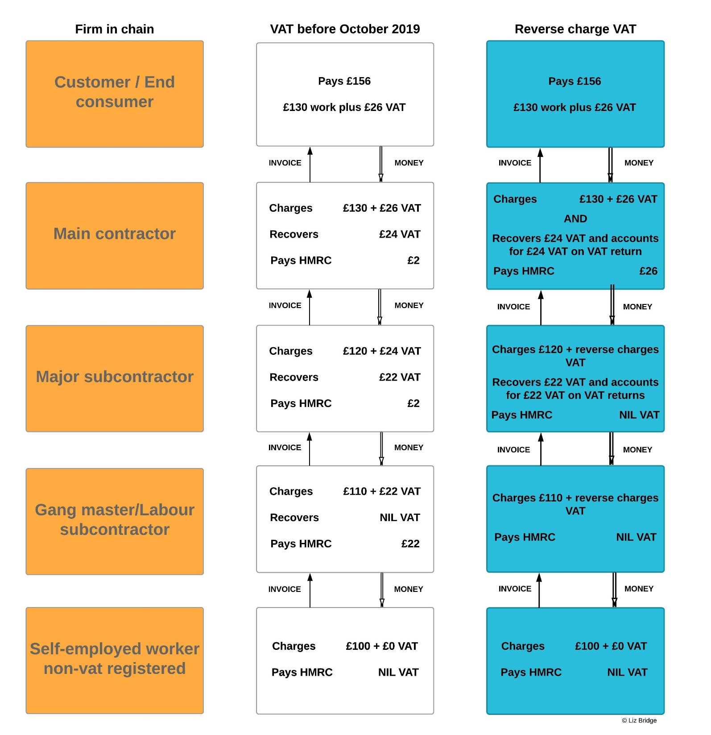
JTC BRIEFING

Slide 4
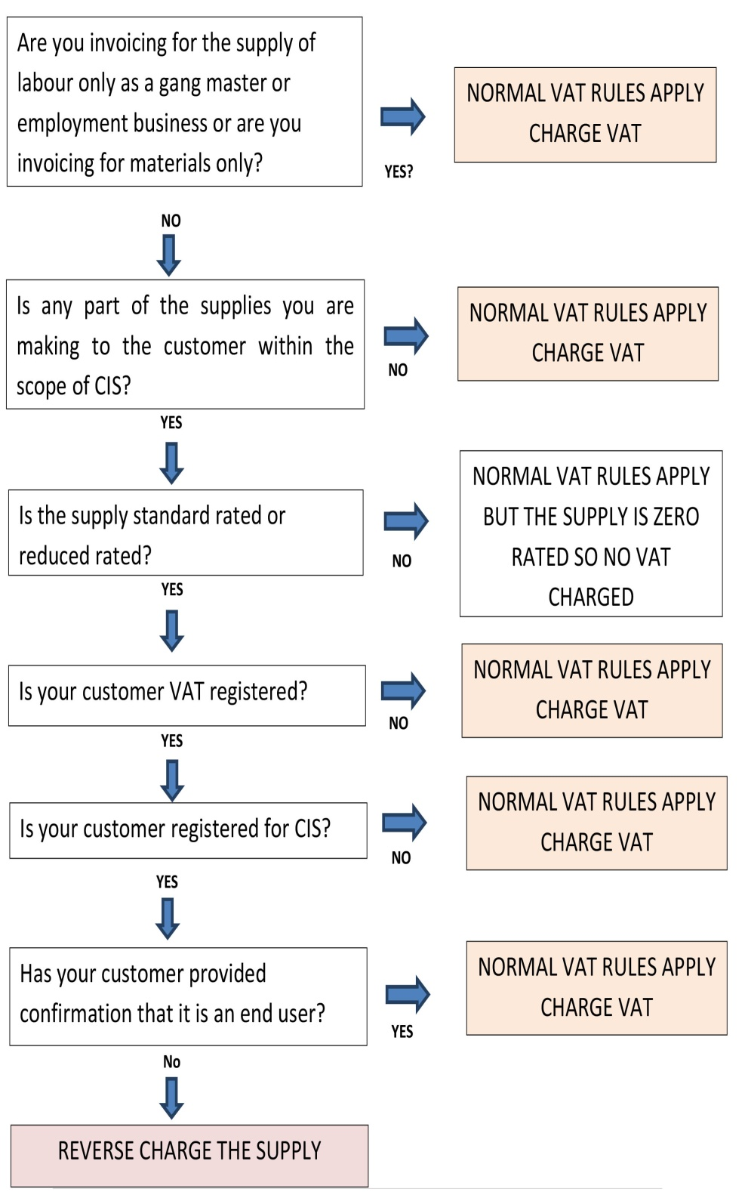
Sending out the correct invoice? Normal or reverse charge?

Slide 5
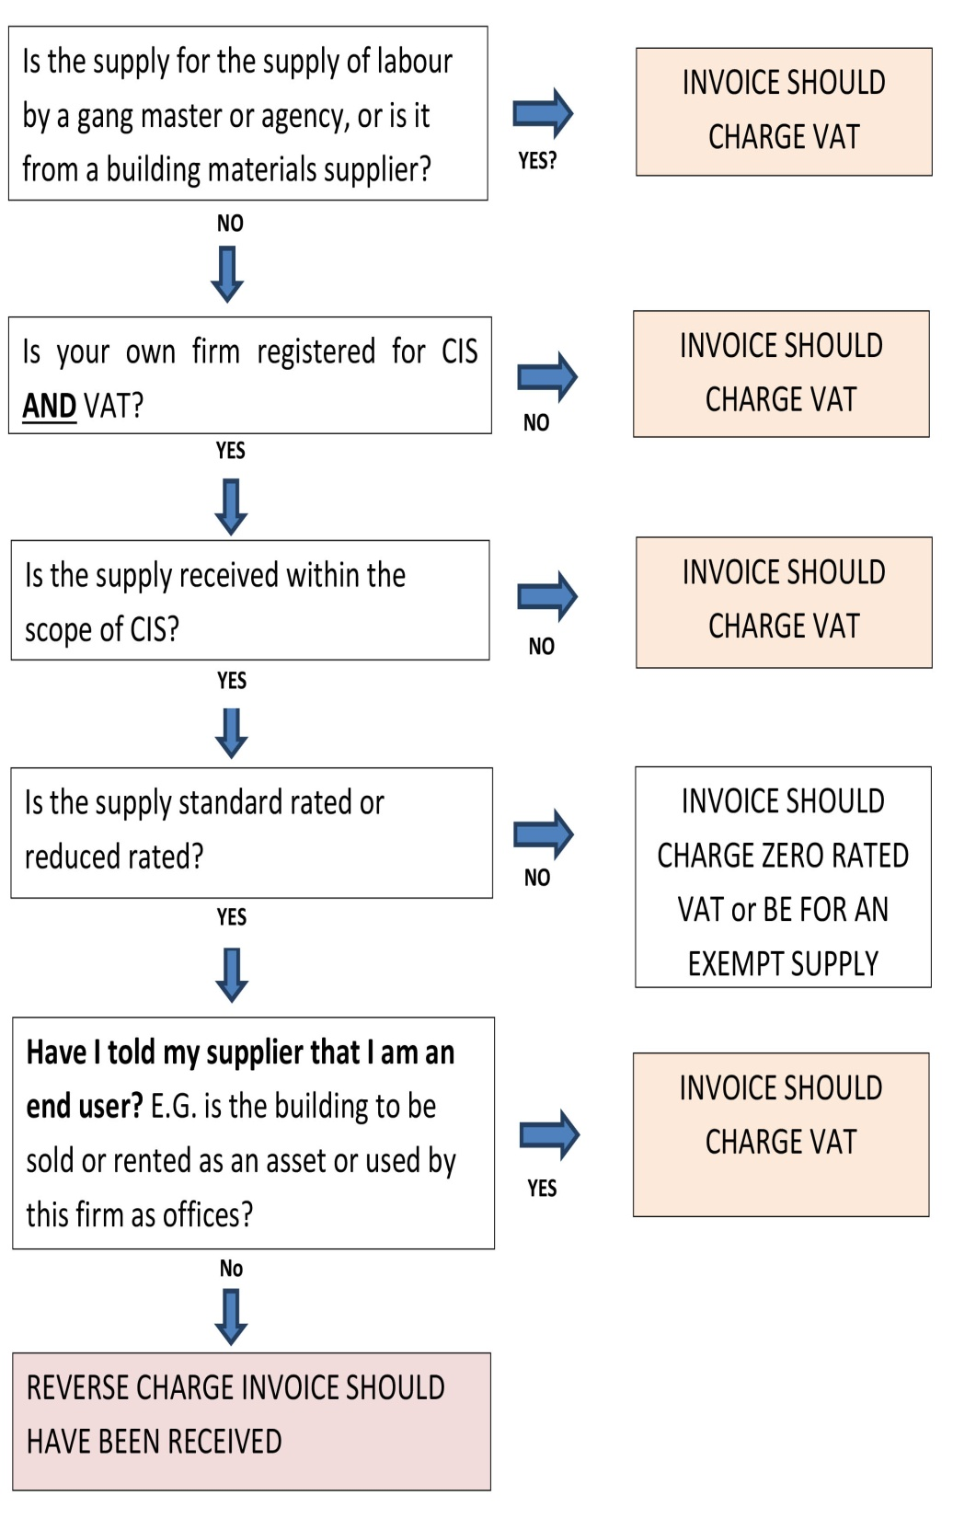
Checking an incoming invoice
This chart is to help businesses receiving an invoice or an application for payment to check whether it is correct in charging VAT or reverse charging.

Slide 6
Who is an end user? Look at who pays you and who you are contracted with 4
Someone who will sell or rent or use the structure --
A Developer
A Landlord
A Local Authority
A Utility Company
A Domestic Householder

Slide 7
Special End Users 6 Local authorities Hospital Trusts Utility Companies

Slide 8
Intermediaries –just a form of End User 4 -a company acting for others in it’s group -a landlord acting for it’s tenants

Slide 9
What does an end user statement look like? 5
We are an end user for the purpose of Section 55A VAT Act 94 (Reverse charge for building and construction services). Please issue us with a normal VAT invoice with VAT charged at the appropriate rate . We will not account for the reverse charge,
Remember to note the specific contract in which the customer is an end user.

Slide 10
End users can stop and start being end users! 6
No apportionments
Next invoice or application for payment to be wholly on the new basis.

Slide 11
Some basic concepts
Decide on a contract by contract basis like CIS. 4
The Scope of CIS –what is in and what is outside. 15
Are you working for an end user –what is an end user?. 4

Slide 12
Do you buy a lot of materials ? 11
Materials only supplies are NEVER reverse charged
If the VAT on the materials you buy exceeds the VAT you will charge the customers/contractors you work for, you will have even greater stress on your cash flow unless you opt to become a monthly repayment trader

Slide 13
What is a monthly repayment trader? 11
They have opted to send in VAT returns monthly
HMRC will generally repay within 10 days
YOU MUST TEST IF IT IS TO YOUR ADVANTAGE

Slide 14
WHAT does a Reverse Charge Invoice look like? 3
It shows the rate of VAT but does not request VAT
It says it is a reverse charge invoice –S55A VAT 1994 applies.
you will need normal invoice formats and reverse charge formats

Slide 15
Interaction of CIS and Reverse Charge 7
For net traders there is a 20%deduction on non materials
BUT everything is reverse charged if appropriate

Slide 16
Transition on 01.03.2021. 8
-Invoice dated on or before 28.02.21 should carry VAT
-Invoice dated 01.03.21 and after should be reverse charged
-Self billing follows the same rule

Slide 17
Transition on 1.03.2021 8
If you have received applications for payment before 01.03.21 which are agreed for payment and are being processed through the transition they can be paid with VAT until 28. 02.2021
If you pay them after 01.03.21 they must be adjusted to reverse charge
Applications after 01.03.21 must be reverse charged

Slide 18
RETENTIONS 9
Just like CIS
Use the VAT regime at the date of payment.

Slide 19
TO DO LIST! Subcontractors 11
Read the government website
Talk to your accountant
Plan out how you will pay your bills through the first quarter of 2021 when cash flow will be at its most difficult
Redesign your invoices and applications for payment
Consider how you will monitor whether your customers are VAT registered and CIS registered
Think about whether you will need to be a monthly repayment trader.
Consider warning letters to your subcontractors
Upgrade software.

Slide 20
TO DO LIST! Contractors 12
Read the government website
Talk to your accountant
Plan out how you will pay your bills through the first quarter of 2021 when cash flow will be at its most difficult
Redesign your invoices and applications for payment
Consider how you will monitor whether your customers are VAT registered and CIS registered
Think about whether you will need to be a monthly repayment trader.
Consider warning letters to your subcontractors
Think about invoicing and payment by end users.

Slide 21
JTC BRIEFING

Slide 22
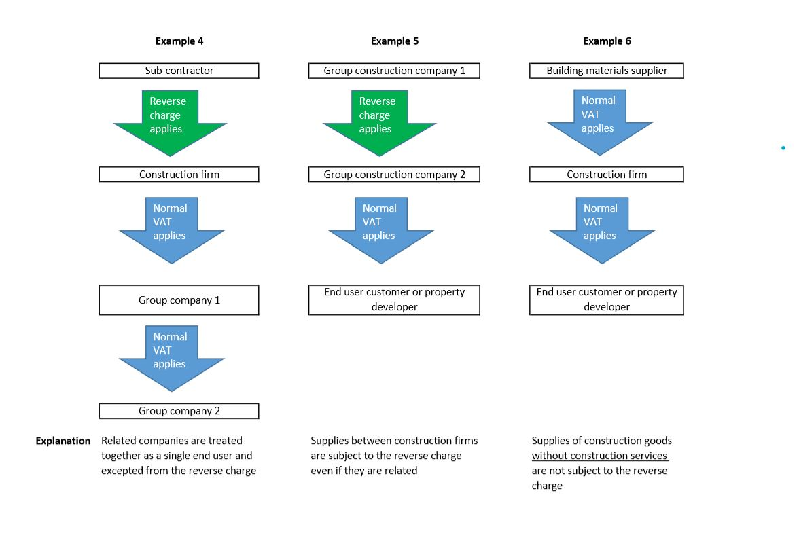
JTC BRIEFING

Slide 23
Do you need help? (Tax Problems Only!)
Liz Bridge
13 Fawe Park Road
London SW15 2EB
0208 874 4335
Liz@thetaxbridge.com
HMRC Business Support Service if you are
running into cash flow problems:
0300 200 3835

